Slide 1
Music Recommendation System
Authors:
Yogesh Jagadeesan
Nitish Krishna Ganesan
Pradeep Kumar Duvvur
Divya Govindarajan

Slide 2
MOTIVATION
Music industry plays a significant role in mining data.
This would benefit the listeners to discover music similar to their liking.
With the advent of Big Data and Analytics, key attributes from songs can be mined to suggest songs.

Slide 3
OVERVIEW
This system suggests songs to users based on their listening history.
Song suggestions are progressively improved based on the user’s liking.

Slide 4
DESIGN CONSIDERATIONS
The data required is preprocessed and normalized to create the following tables
User_System
Song
Instrument
Artist
User_To_Instrument
User_To_Song
Song_To_Artist
Song_To_Instrument

Slide 5
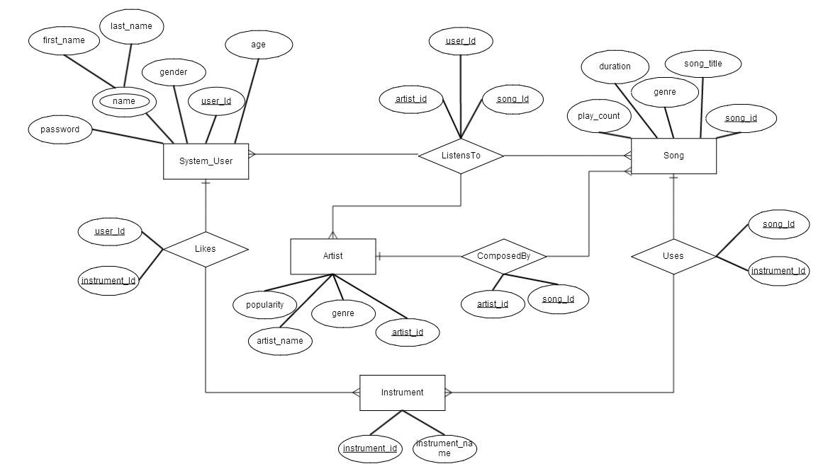
E-R DIAGRAM

Slide 6
ARCHITECTURE
The data is stored in ORACLE.
Clustering technique is performed by using WEKA mining tool.
UI was done using PHP, HTML and CSS.

Slide 7
IMPLEMENTATION
Clustering was done using K-Means clustering algorithm.
Songs were clustered into 6 clusters based on the genre, artist, duration and play count.
Based on the cluster in which a song exists and the cluster of songs that the user likes, songs are recommended.

Slide 8
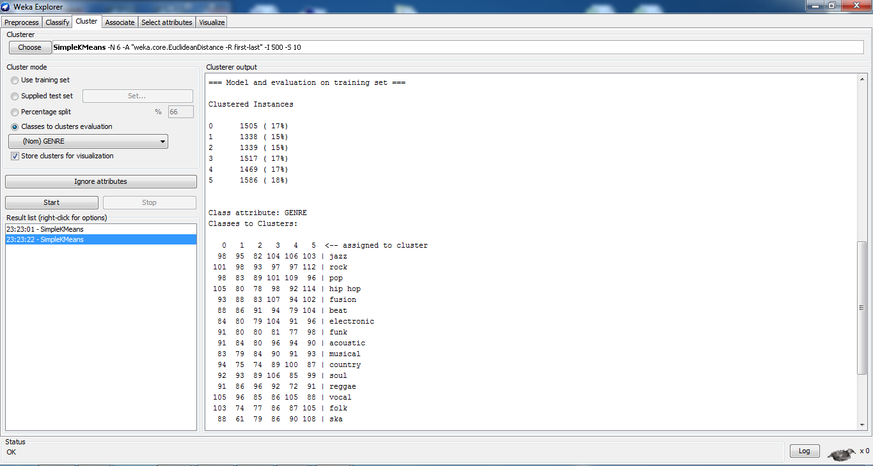
RESULT OF MINING

Slide 9
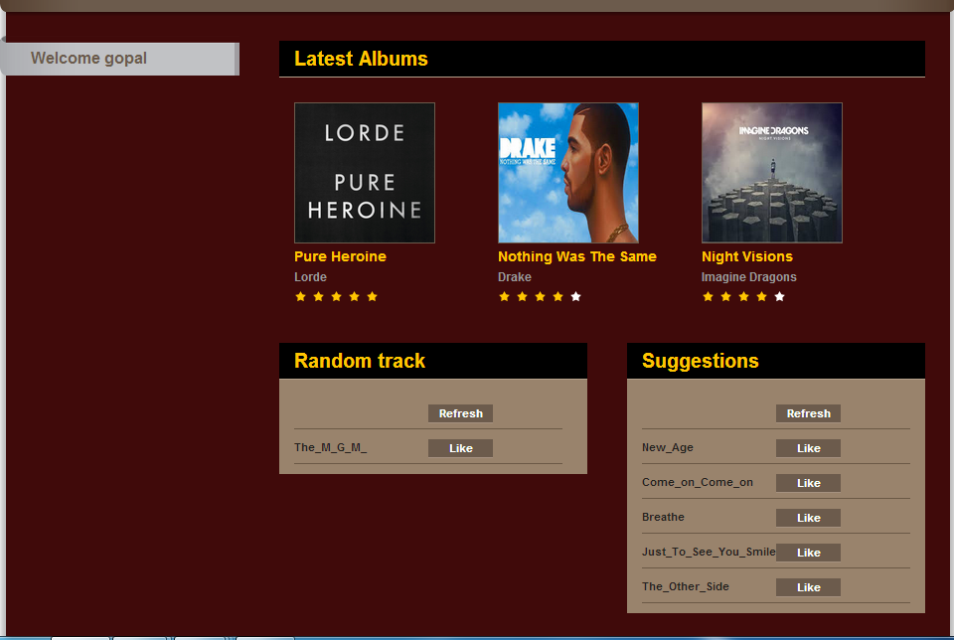
USER INTERFACE

Slide 10
THANK YOU !

